Slide 1

SYSTEM SIMULATION PROJECT ON SUBWAY TICKET QUERY SYSTEM
Instructor Student
CJ WU Pavan Chaitanya

Slide 2
INDEX
Executive Summary
Objective
Overview
Scope
Initial Model (Model-1)
Model Setup
Overview of the Model
Model Results
Alternate Model (Model-2)
Model Setup
Overview of the Model
Model Results
Insights and Conclusion
References

Slide 3
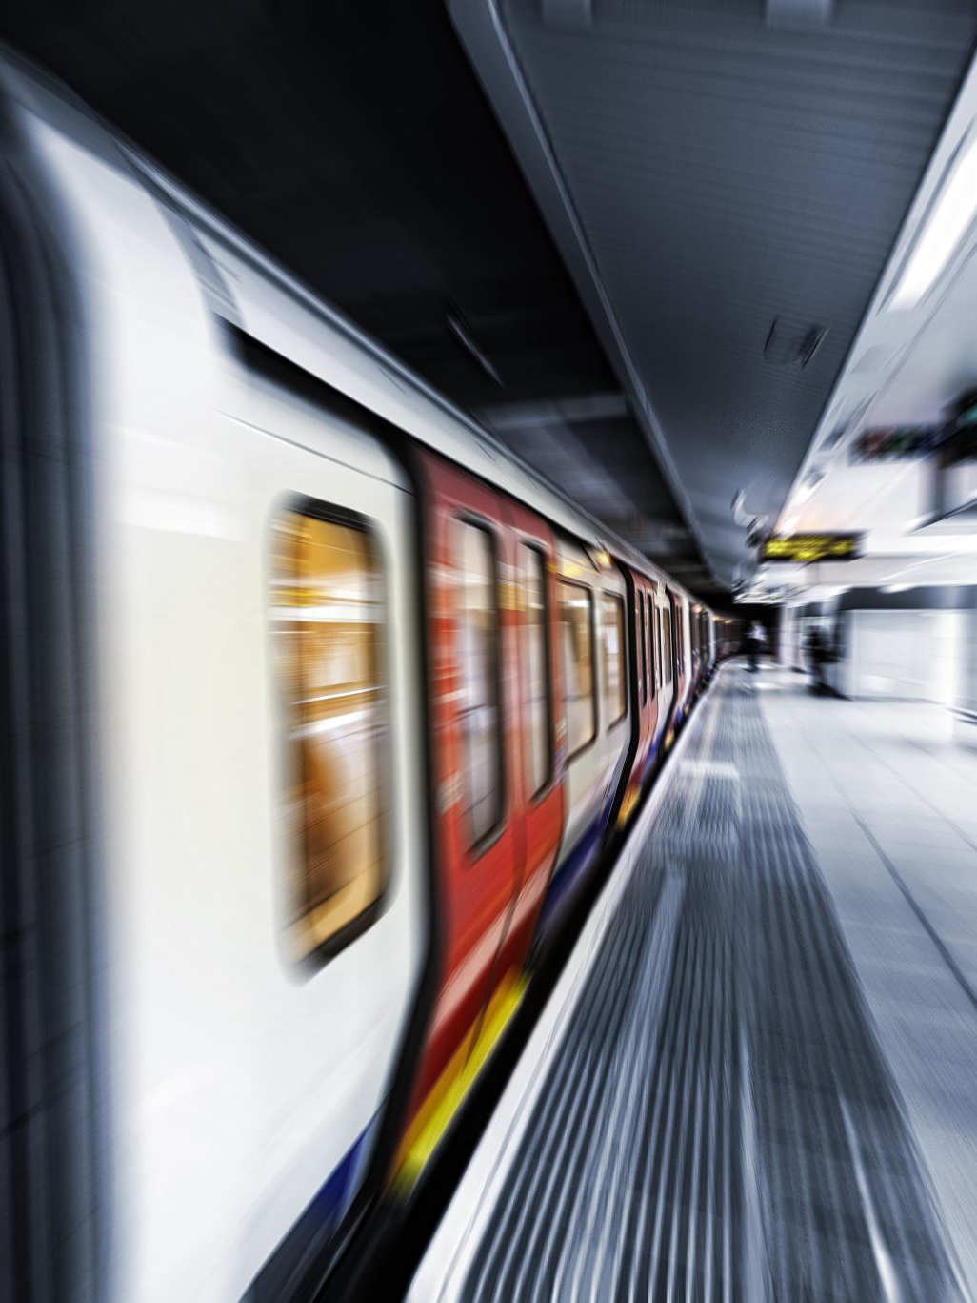
EXECUTIVE SUMMARY
This ppt presents a detailed study of the rail metro ticket queuing system at metro station using various simulation methods​
The study aimed to optimize the queuing system for purchasing tickets, which aimed to reduce waiting times and enhance passenger experience the first example highlighted the challenges faced by passengers due to queuing therefore, which resulted in long wait times and possible ticket cancellations Passengers can go to the station and choose their queue​
These improvements are expected to improve the overall efficiency of the ticketing process, reduce wait times, and improve customer satisfaction The findings of this study provide valuable insights for Subway to improve its queuing process and improve service delivery

Slide 4

Objective
The objective of the simulation observation is to optimize the queuing device for ticket purchases at a Subway. The current system experiences long queues, resulting in passenger dissatisfaction and potential ticket cancellations. The aim is to improve the queuing system by reducing waiting times and enhancing overall efficiency to enhance the passenger experience.
By utilizing discrete event simulation in Arena software, the study aims to recommend and analyze alternative scenarios that can optimize the queuing system. The simulation results will provide valuable insights into potential improvements and assist in decision-making to streamline the ticketing system. The findings will guide the implementation of the most effective solution for enhancing the queuing process at the Subway.

Slide 5
Overview
The ppt focuses on designing efficient ticket queuing systems on subways, considering the entire passenger experience from entry to exit at the ticket counter. The study aims to address challenges such as long queues, passenger frustration, and potential ticket cancellations.
By utilizing Arena software to simulate different scenarios, the analysis aims to optimize the queuing process and propose improvements. The objective is to enhance passenger satisfaction, prevent queuing congestion, and improve overall efficiency in the subway, providing valuable insights for improving the ticketing system.

Slide 6
Scope
The scope of this study encompasses the queuing gadget for ticket purchases at a Subway​
The study specializes in addressing the demanding situations posed by long queues, which could result in passenger dissatisfaction and ability price ticket cancellations​
The findings will guide choice-making and offer suggestions for streamlining the ticketing manner to keep away from long queues and beautify passenger delight on the Subway

Slide 7
Initial Model Setup(Model 1)
Set up :
Resources
Ticket Issuer 1
Ticket Issuer 2
Stations & Route Logic Enter station
Exit station to platform
Ticket Counter station
Queue line.
Queue Station
Schedules Arrival schedule -
Ticket Issuer
Expressions Slow arrival
Busy arrival
order time
pay time
Sets Customer type.
Customer picture
Attributes Process time
Variables Walk time

Slide 8
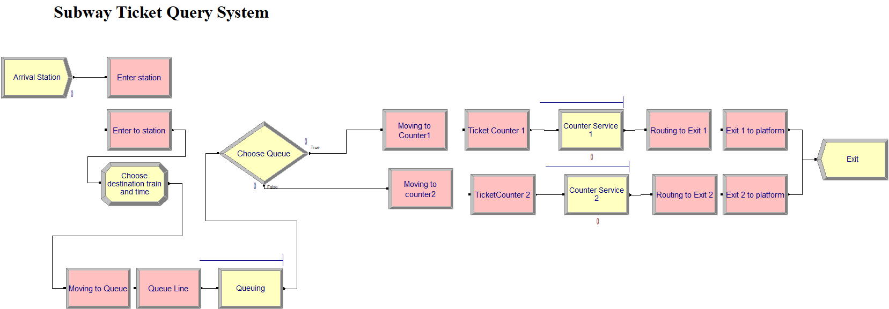
Overview of Model 1

Slide 9
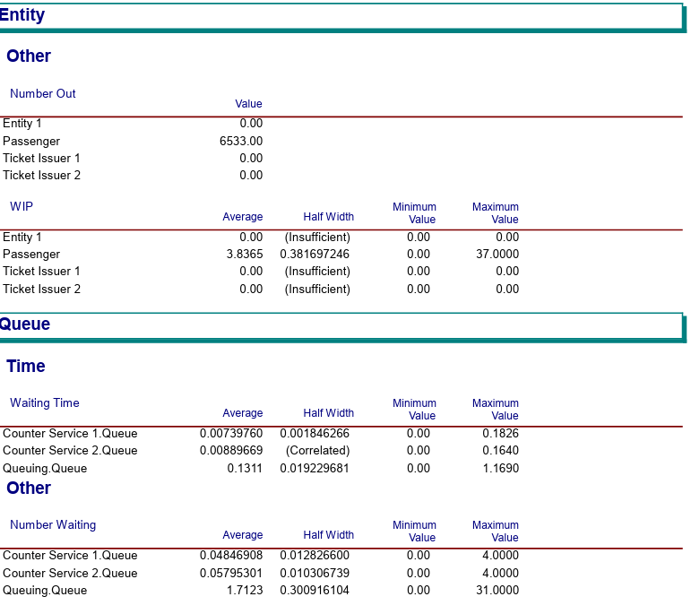
Model1 Results
Based on the results, it is obtained that the average queue time of simulation is 0.131 minutes with an average number of 1.71 people per minute. Service time at counter 1 is 0.07 minutes with an average number of 0.048 per minute. The service time at counter 2 is 0.08 minutes with an average amount of 0.057 per minute.

Slide 10
Alternate Model Setup (Model 2) In addition to the initial model, an alternative queuing system solution is proposed to reduce queue lengths for passengers at the Subway
Set up :
Resources
Ticket Issuer 1
Ticket Issuer 2
Stations & Route Logic Enter station
Exit station to platform
Ticket Counter station
Queue line.
Queue Station
Schedules Arrival schedule -
Ticket Issuer
Expressions Slow arrival
Busy arrival
order time
pay time
Sets Customer type.
Customer picture
Attributes Process time
Variables Walk time

Slide 11
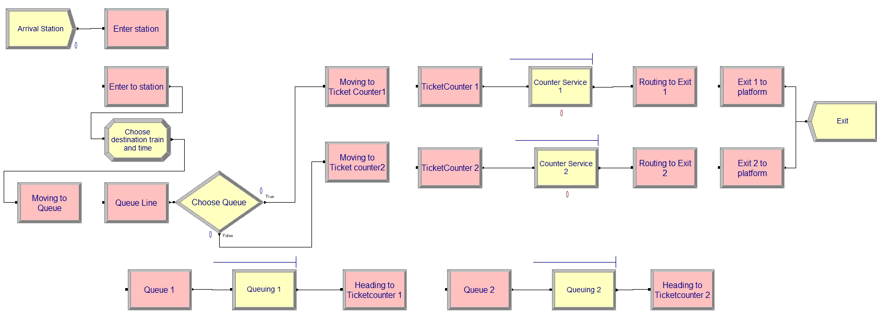
Overview of Model 2

Slide 12
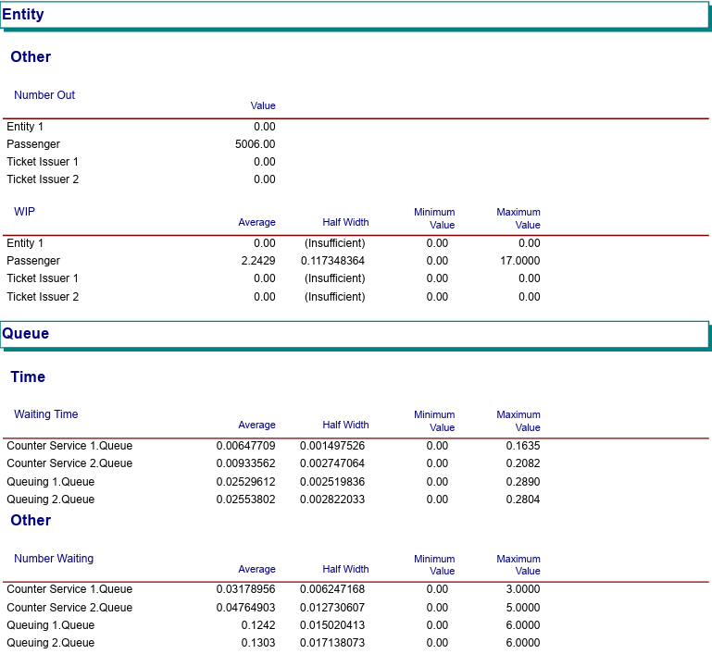
Model2 Results
Based on the results, it is obtained that the average queue time of simulation in Queues 1 and 2 are 0.025 and 0.025 minutes with an average number of 0.12 and 0.13 people per minute. Service time at counter 1 is 0.006 minutes with an average number of 0.031 per minute. The service time at counter 2 is 0.009 minutes with an average amount of 0.047 per minute.

Slide 13
Insights and Conclusion
The simulation results of the railway metro ticket queuing system of Subway provide valuable insights for optimizing the queuing system for ticketing
The original prototype identified existing challenges, such as long waiting times due to queue queues, which resulted in dissatisfied passengers and possible ticket cancellations, but the new prototype showed a marked improvement by way of it is used to select passengers to be selected over the queue
Simulation results provide strong evidence that the inclusion of queuing routes effectively reduces queue length and improves scheduling efficiency by adopting this solution, stations can better manage passenger flows, for improve service, and reduce customer dissatisfaction caused by long queues Queue systems

Slide 14

References
https://ieeexplore.ieee.org/document/5768318​
https://www.youtube.com/watch?v=M5XKBRdIKCE​
​

Slide 15
Thank You

